Slide 1
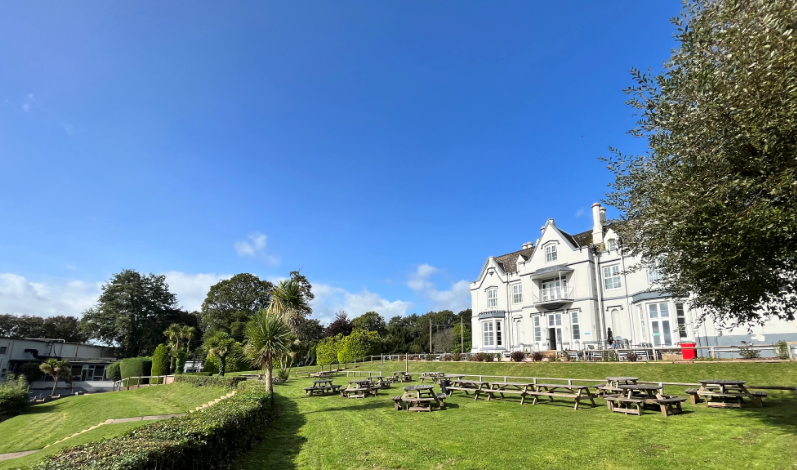
Barton Hall
21st – 25th June 2027

Slide 2
Pricing
PGL Barton Hall = £471.27
Price includes accommodation, food and all activities from Monday afternoon until Friday afternoon.
Transport cost = £40
Total = £511.27 (approximate based on 65 attending)

Slide 3
Payment schedule
£65 (non-refundable) paid in June
£125 required by 30th September 2026 (if not paid, please do)
£100 by 14th December
£100 by 26th February
Final balance payment (£121.27) by 12th April 2027
Payments can be made as and when you’re able to in order to meet the schedule.
Two spaces left - £190 (non refundable)

Slide 4
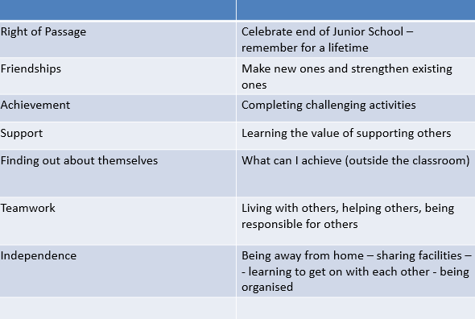
Aims

Slide 5
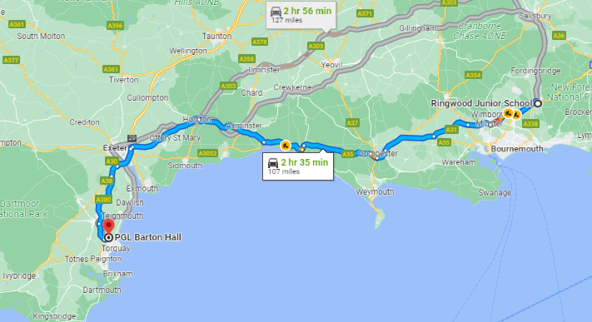
Travel
Nearest Emergency Dept is Torbay Hospital (1.9 miles)

Slide 6
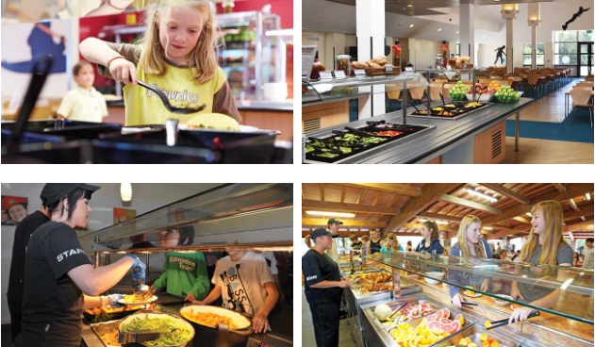
Food

Slide 7
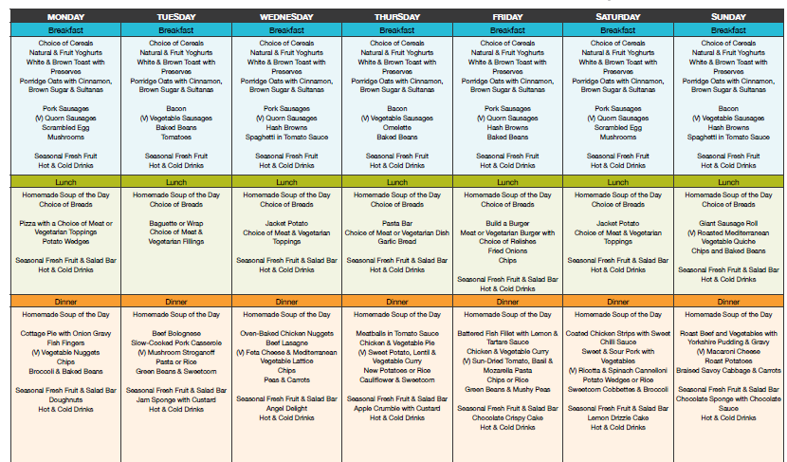

Slide 8
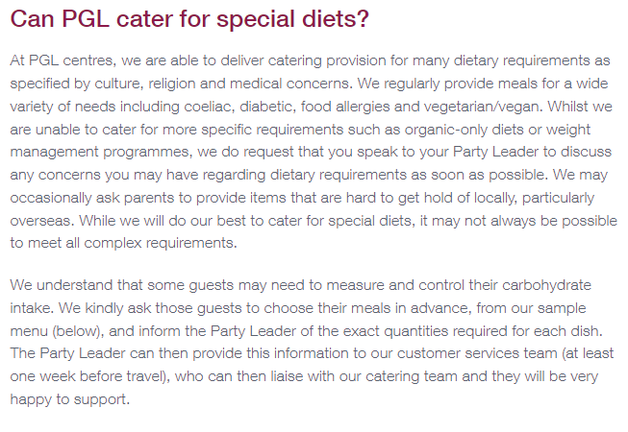

Slide 9
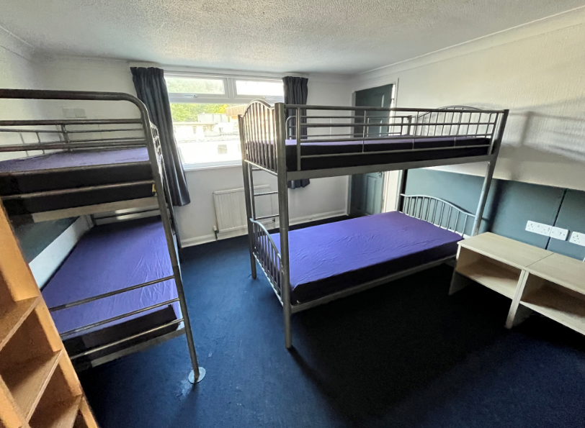
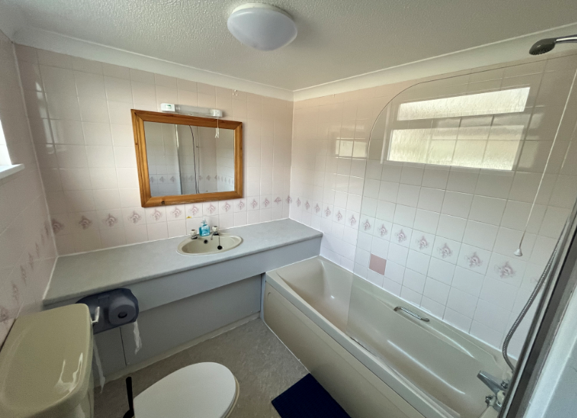
Accommodation
Main House
6 pupils (same sex) to a room
En-suite for each room
All on the same floor
Adult rooms are positioned to the ends and middle of the corridor.
Doors are lockable from inside (teachers will have keys to all rooms for safety reasons)
Teacher lounge is situated in main house building.

Slide 10
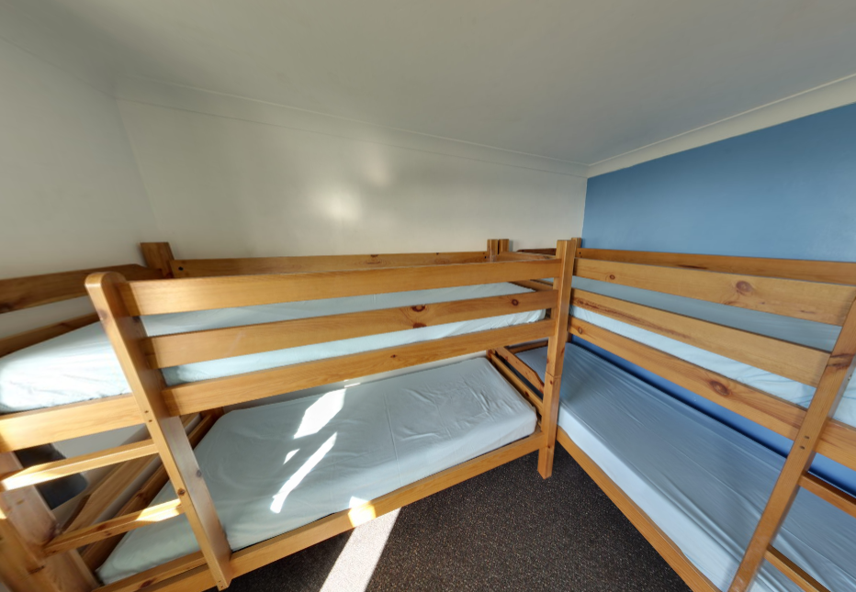
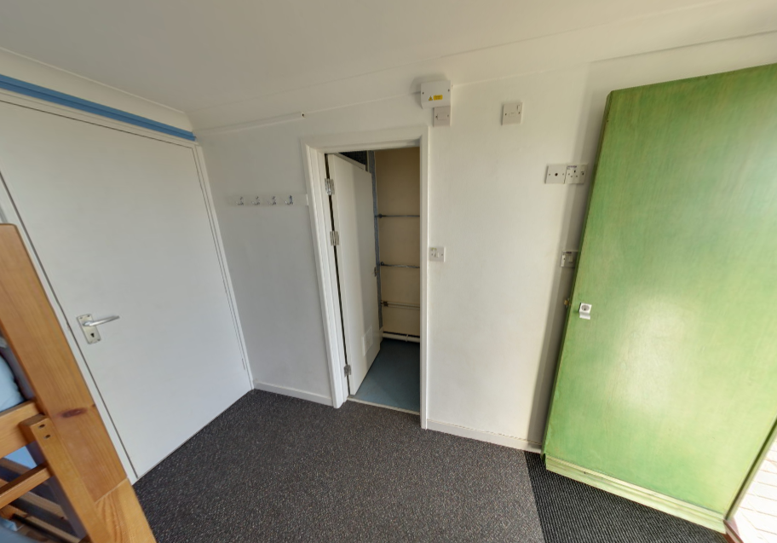
Chalet
4 pupils (same sex) to a room
En-suite in each room
Rooms have direct access to pathways and green spaces for breaks etc.
Adult rooms are situated to the ends and middle of the chalet rooms.
Doors are lockable from inside (teachers will have keys to all rooms for safety reasons)

Slide 11
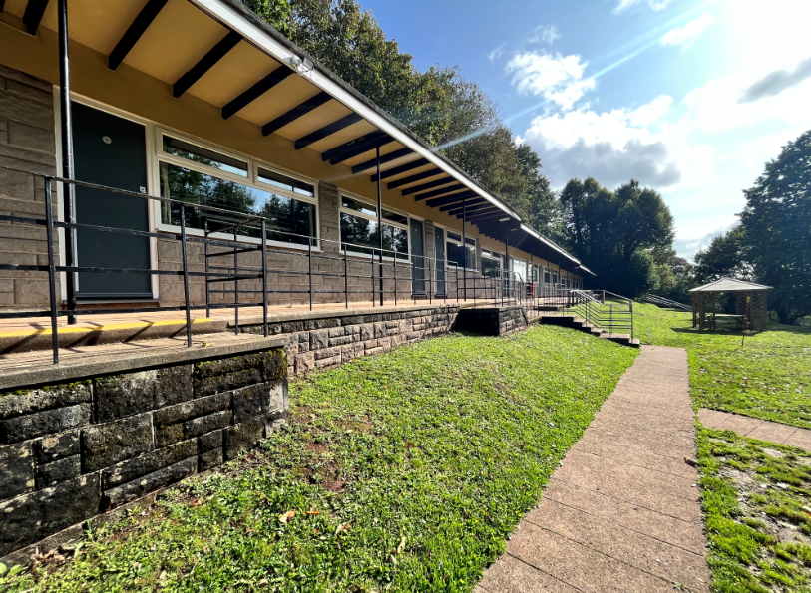
Notes:
Many sites in UK, in France & Spain, RJS (as long….12 years) because…

Slide 12
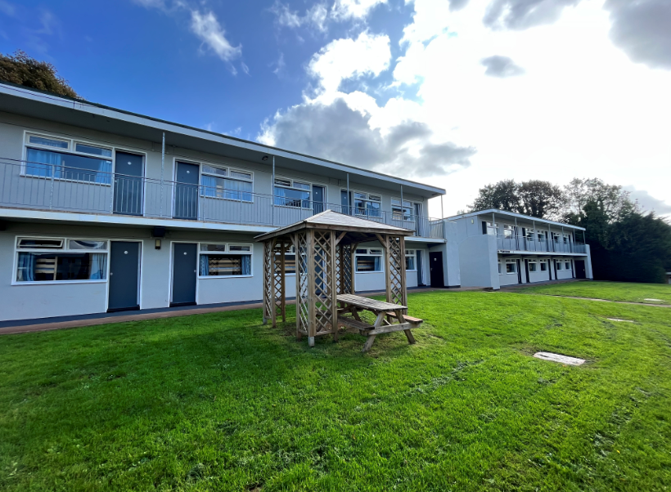

Slide 13
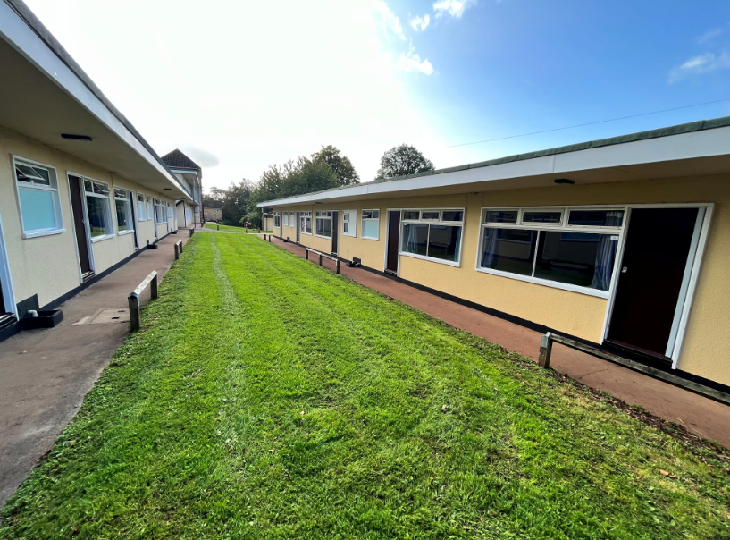

Slide 14
Ratios
Children will be split into activity groups – up to 12 per group depending on the amount of children attending the residential.
With each group there will be an assigned adult from school in addition to the Activity Leader(s) provided by PGL.

Slide 15
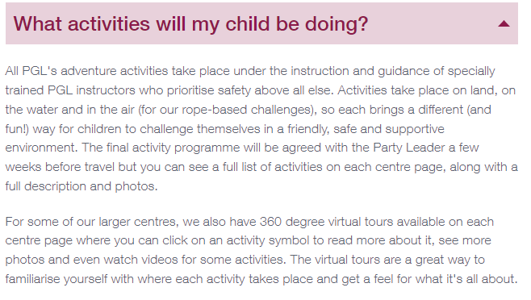
Activities

Slide 16
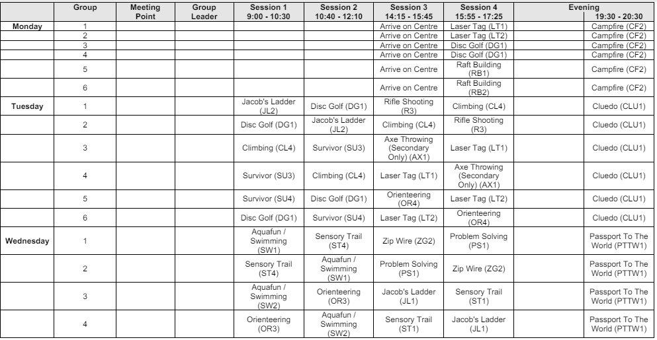

Slide 17
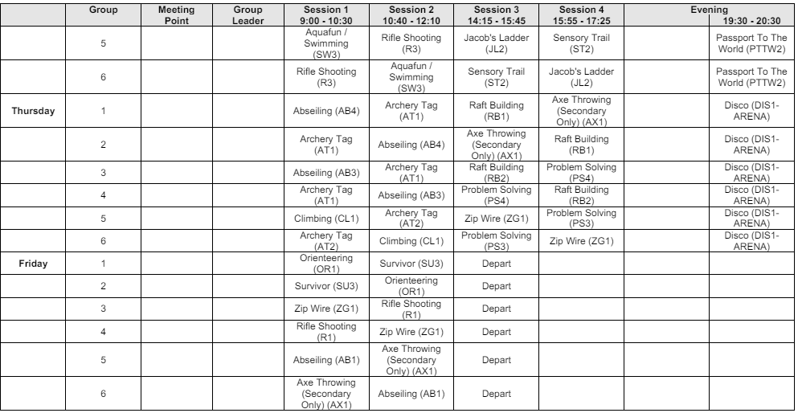

Slide 18
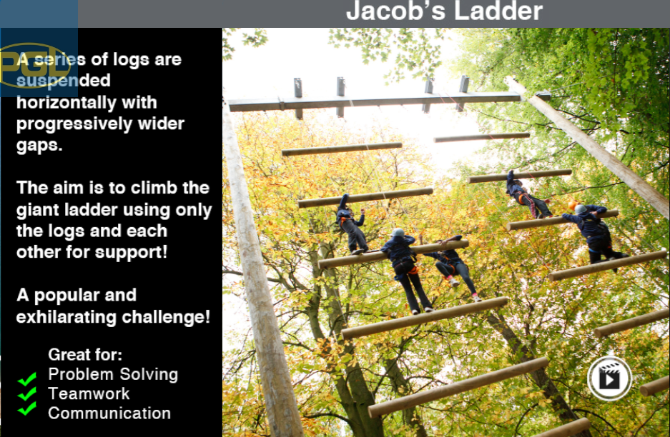

Slide 19


Slide 20
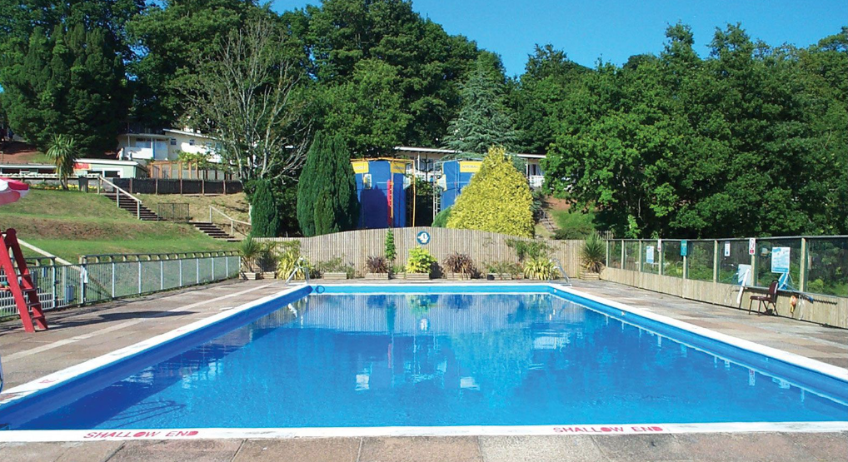
Outdoor heated swimming pool
Lifeguards
Two sessions to choose from – free swim or pool games session.

Slide 21
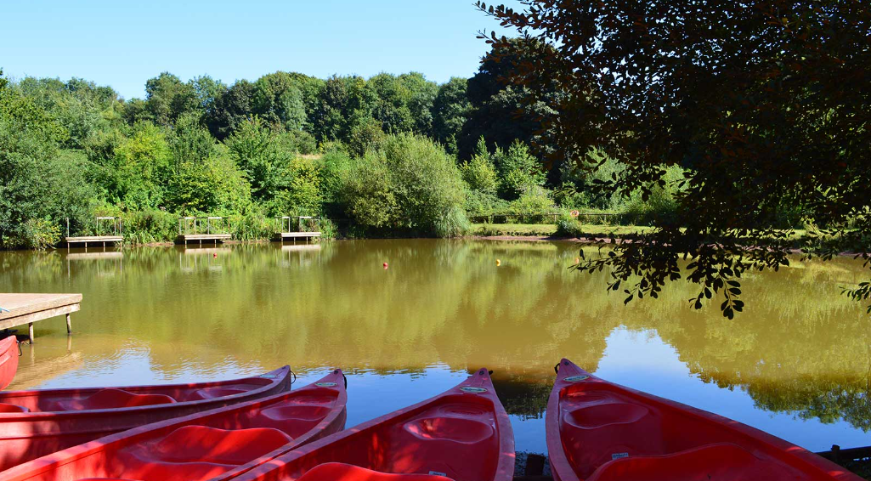
Own lake
Kayaking/canoeing
Paddleboarding
Skills and games

Slide 22
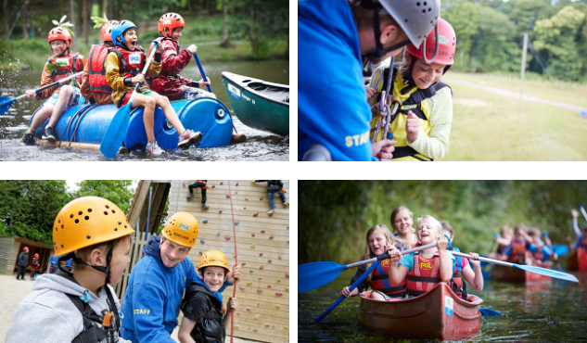
Other activities include:
Raft building
Orienteering
Rifle shooting
Survivor
Sensory trail
Giant swing
Fencing

Slide 23
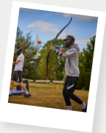
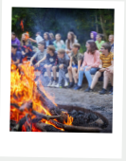
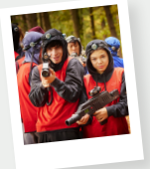
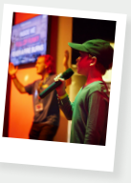
Typical Evening Activities
Karaoke
Ambush
Crepe making
Disco
Laser 360
Balloon splash
Campfire
Archery Tag

Slide 24
Going to Bed
9:00pm to accommodation
10:00pm lights out
4 children……go to sleep!!

Slide 25
Money
Up to £20
Named wallet/purse/envelope/pre-loaded bank card
Kept with their group leader
Shop

Slide 26
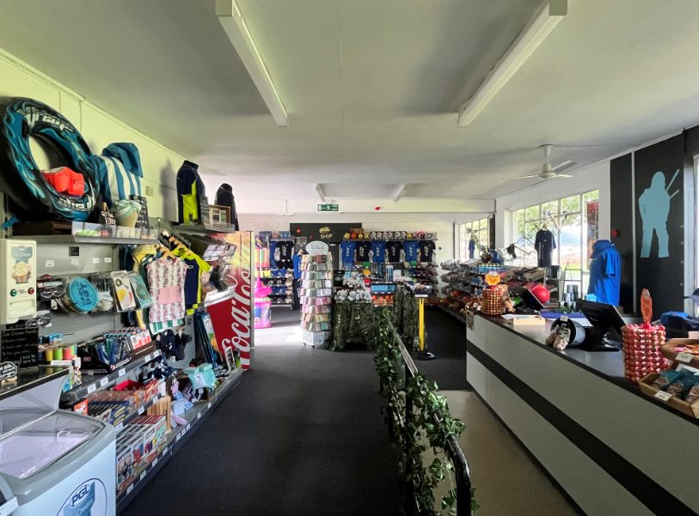

Slide 27
Medications
Prescription medication – pharmacy label with name, dosage and name of medication.
Antihistamines/ travel sickness tablets etc (other shop bought medications) – labelled with child’s name please.
All medication to be in a clear plastic bag which is named.
Medical forms – instructions etc.

Slide 28
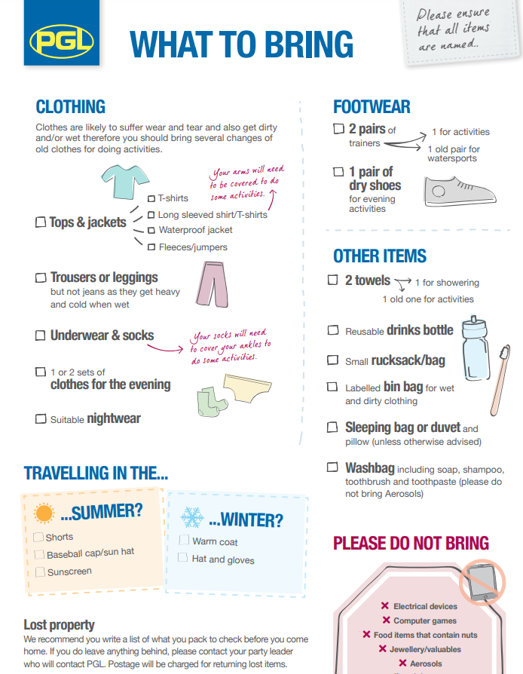
No aerosols including insect repellent – roll on only please.
Enough sun cream
No mobile phones or any other valuable devices such as apple watches, Nintendo switch etc.
No jewellery or valuables

Slide 29
Information Forms
When numbers and places are confirmed.
Medical needs e.g. conditions, medications.
Swimming ability
Contact information (taken in folder by Trip Leader)

Slide 30
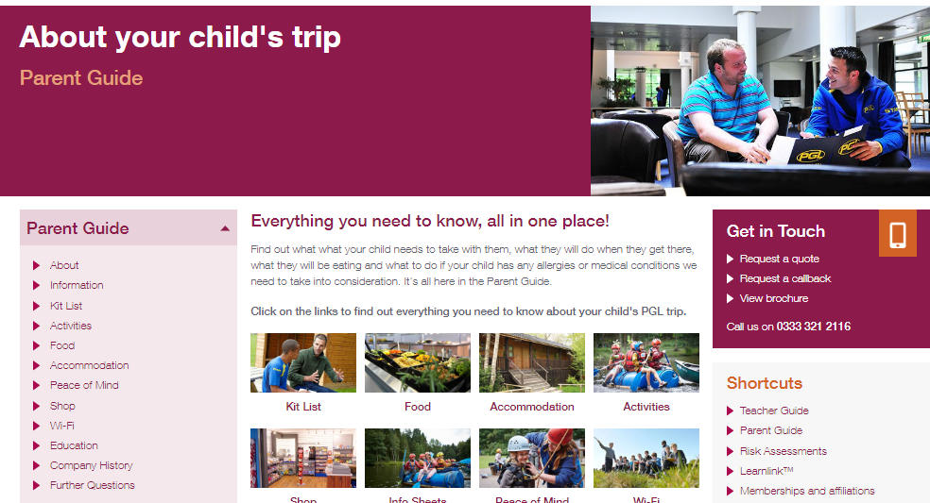
Parent Guide

Slide 31
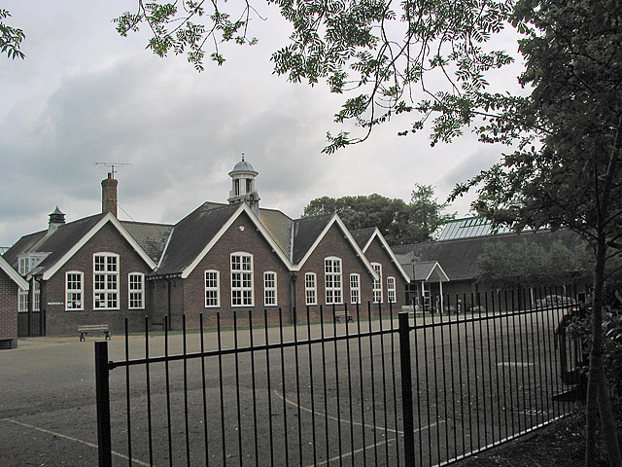
Return to Ringwood Junior School
Arrive back on Friday (time tbc)
Exhausted…but happy

Slide 32
Useful links
https://www.pgl.co.uk/Files/DocumentManagerDocuments/AdventureUK/Evening%20Entertainment/PGL-Barton-Hall-Evening-Activities.pdf
https://www.pgl.co.uk/Files/DocumentManagerDocuments/AdventureUK/PGL-Gift-Shop-Price-List.pdf
https://www.pgl.co.uk/Files/DocumentManagerDocuments/Web/Kit%20Lists/PGL-Kit-List-UK.pdf
https://www.pgl.co.uk/Files/DocumentManagerDocuments/Web/Kit%20Lists/PGL-What-To-Wear-Checklist.pdf

Slide 33
Questions?

