Slide 1
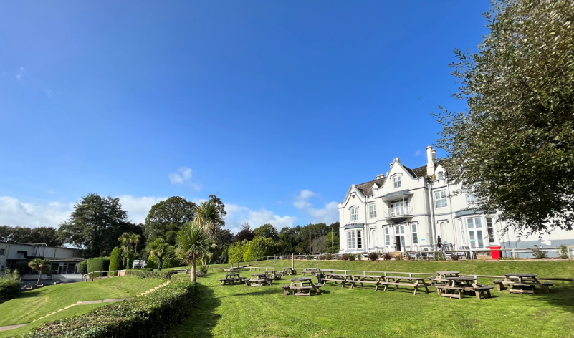
Barton Hall
2026

Slide 2
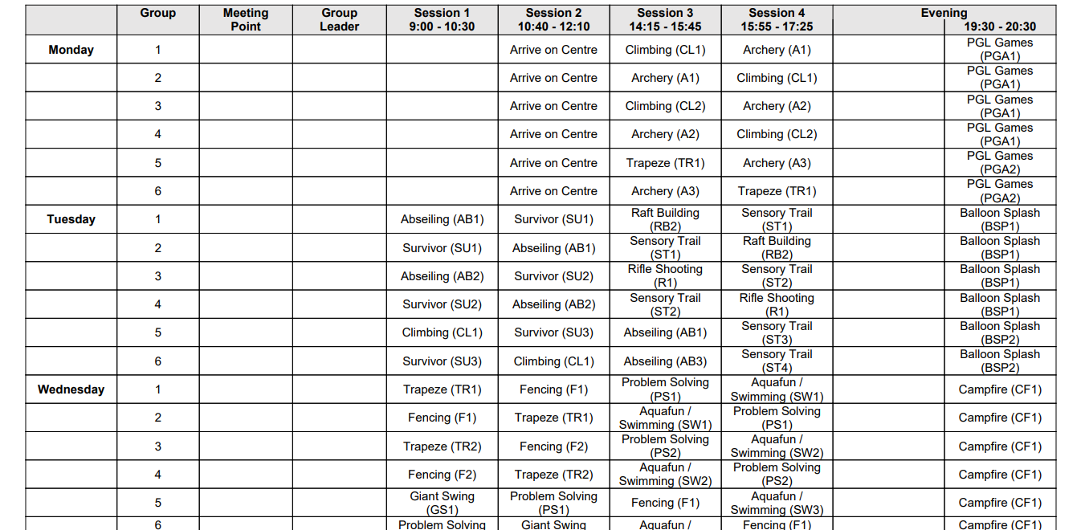

Slide 3
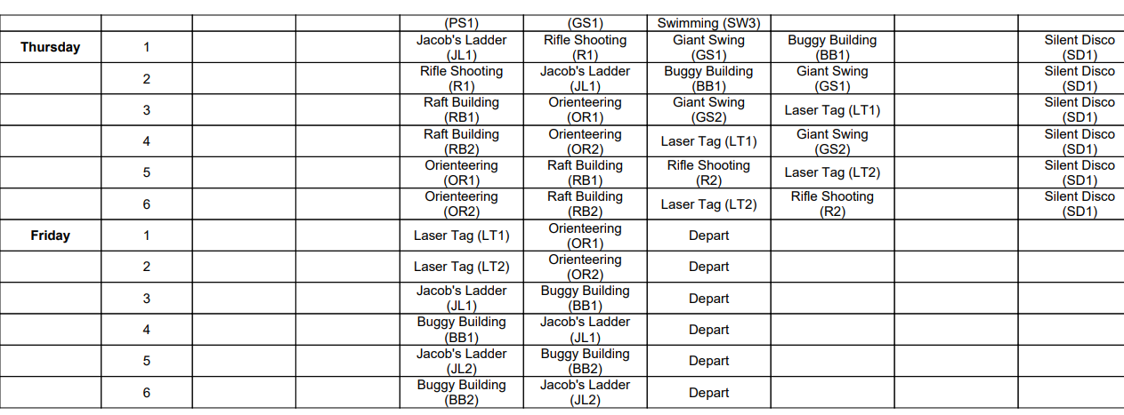

Slide 4
Money
Up to £20 cash or prepaid card
Named wallet/purse/envelope
Kept with their group leader
Shop

Slide 5
Snacks
2 small (500ml) bottles of fizz
2 bags of sweets (200g max each)
One small savoury snack per day- breakfast bars, crisps, biscuits
No nuts

Slide 6
Medications
Prescription medication – pharmacy label with name, dosage and name of medication.
Antihistamines/ travel sickness tablets etc (other shop bought medications) – labelled with child’s name please.
All medication to be in a clear plastic bag which is named.
Medical forms – instructions etc.

Slide 7
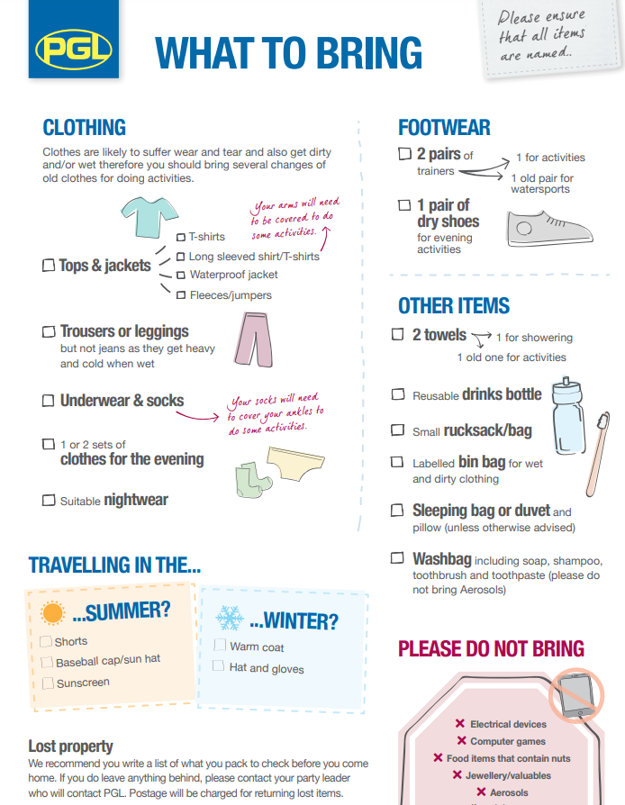
No aerosols including insect repellent – roll on only please.
Enough sun cream
No mobile phones or any other valuable devices such as apple watches, Nintendo switch etc.
No jewellery or valuables

Slide 8
Arrival at school on 15th June
08:20-8:30 arrival
School Hall
Numbered tables (groups, medical)

Slide 9
Departure on 19th June
Departure time is 14:15-15:45.
We will send a message once departed.
Anticipated from 17:00 but will update on route for more accurate. School will inform you.

Slide 10
Questions?

