Slide 1
Year 6 SATs meeting- February 2026

Slide 2
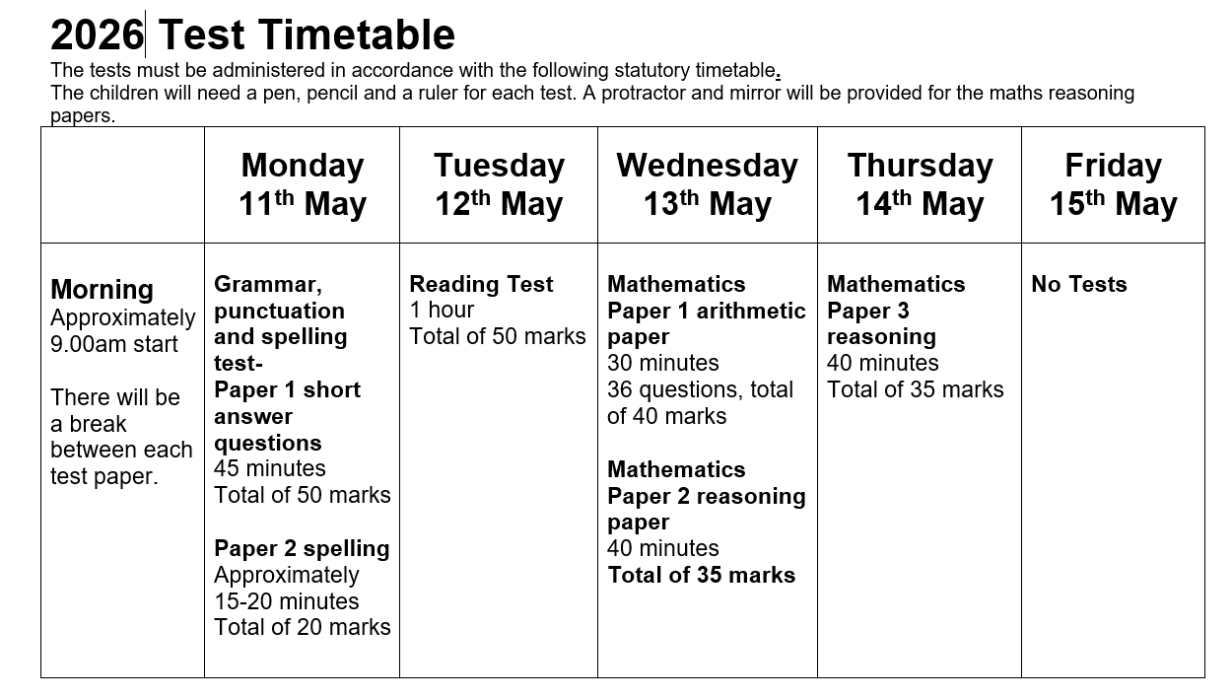
Notes:
NW

Slide 3

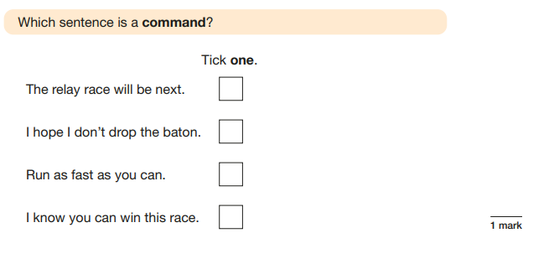
Grammar, punctuation and spelling test.- Paper 1 short answer questions 45 minutes Total of 50 marks
Notes:
NW

Slide 4

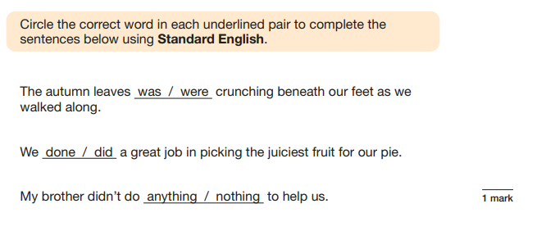

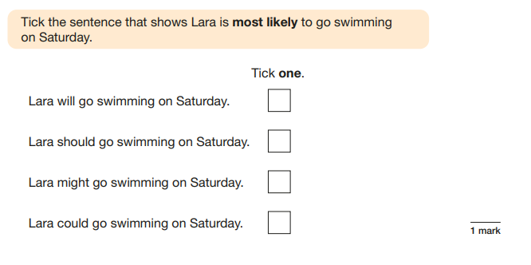

Slide 5
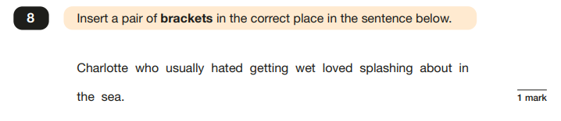
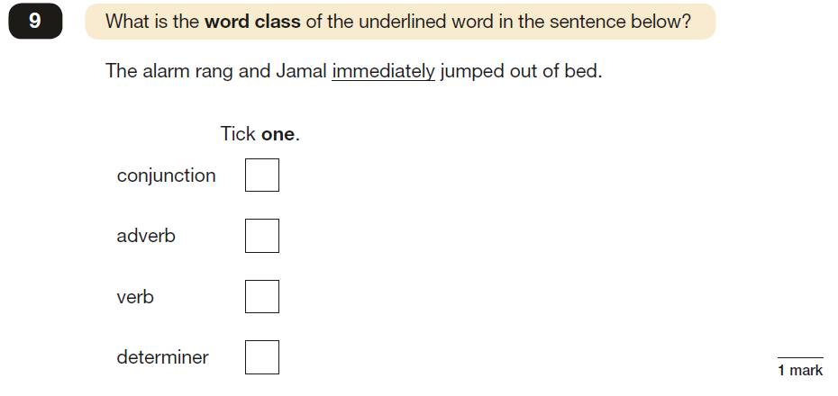

Slide 6

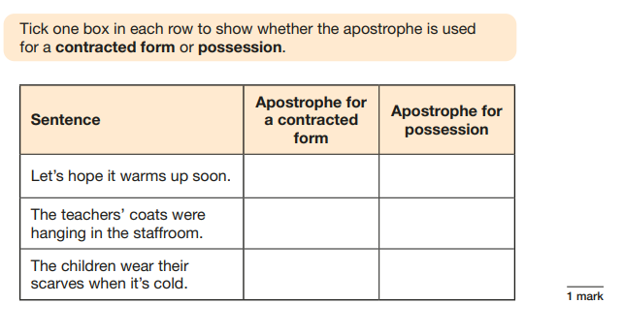
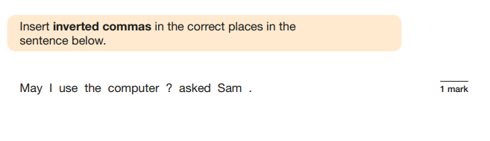


Slide 7

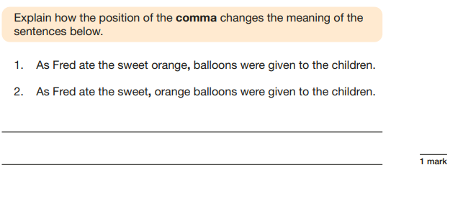

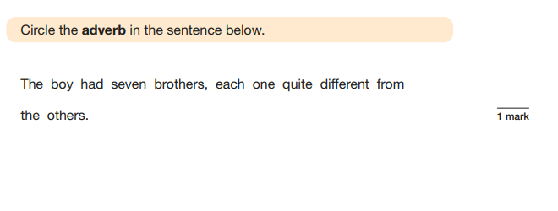

Slide 8

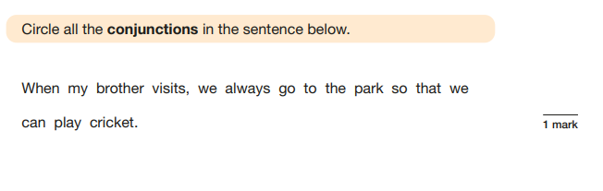
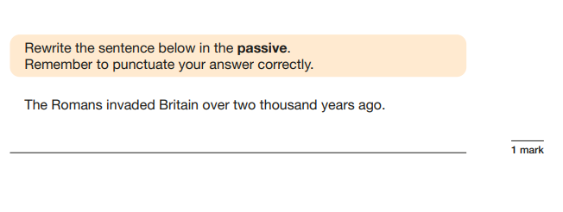


Slide 9
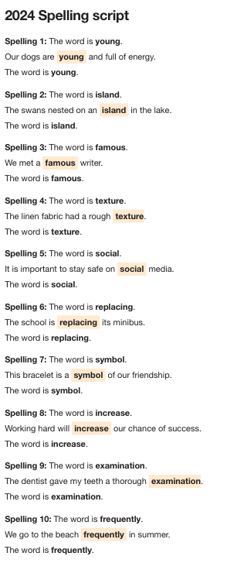
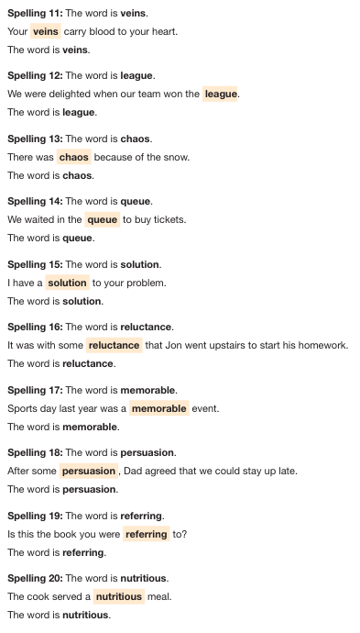
Paper 2 spelling Approximately 15-20 minutes Total of 20 marks

Slide 10
Grammar and spelling test Results Grammar paper is out of 50 marks Spelling paper is out of 20 marks Results from both are added together to give an overall test score, this is then translated to a standardised score. A standardised score of 100-109 is classed as the age related expectation. 110 and above is at greater depth/higher standard. For the 2025 paper you needed to score at least 35/70 marks to score age related expectation. 54/70 marks would have been greater depth/ higher standard.

Slide 11

Reading Test 1 hour 3 texts Total of 50 marks
Notes:
AM

Slide 12
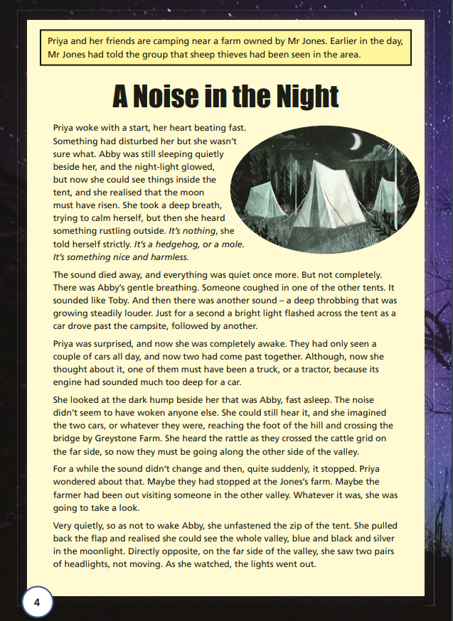
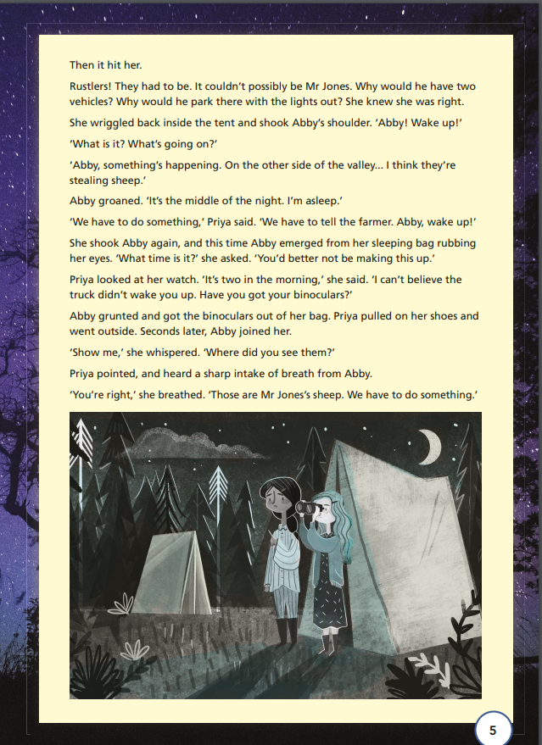

Slide 13

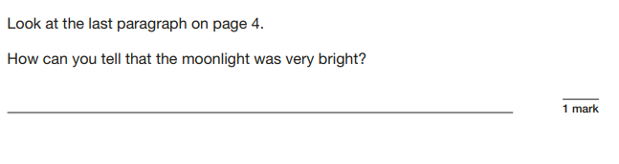

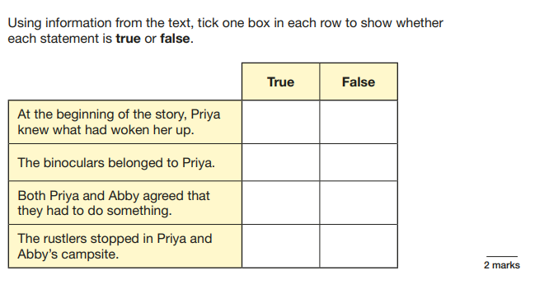
Inference
Retrieval

Slide 14

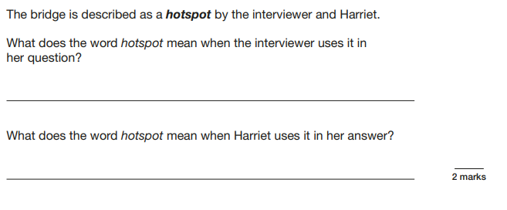
Give or explain words in context

Slide 15

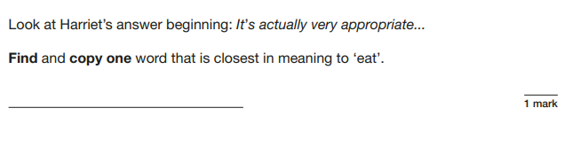

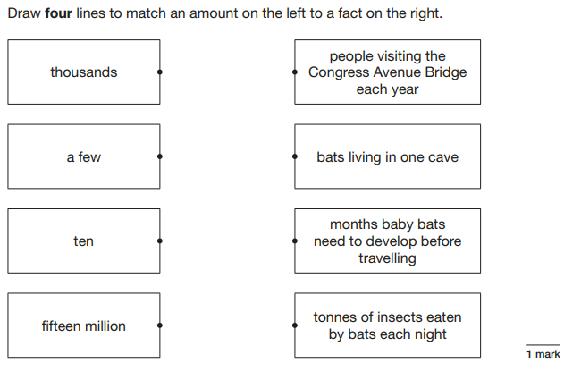
Retrieval
Retrieval

Slide 16

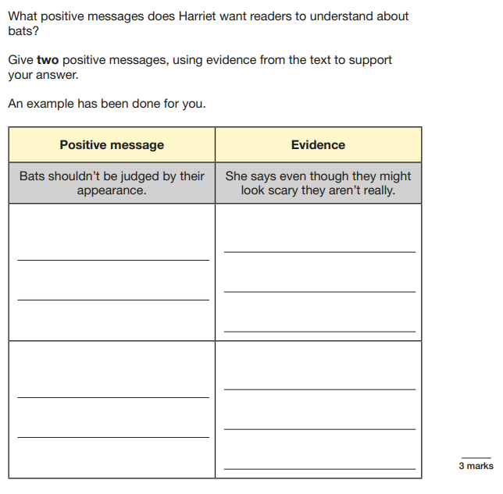
Inference

Slide 17
Reading test Results The reading paper consists of questions on retrieval, inference, vocabulary, sequencing/ordering and comparison. The reading paper is out of 50 marks A standardised score of 100-109 is classed as age related expectation. 110 and above is at greater depth/ higher standard. For the 2025 paper you needed to score at least 28 marks to score age related expectation. 40 marks would have been greater depth/higher standard. Previous guidelines have indicated Year 6 pupils are expected to read at approximately 150-170 words a minute.

Slide 18







Mathematics Paper 1 arithmetic paper 30 minutes 36 questions, total of 40 marks
Notes:
LD

Slide 19
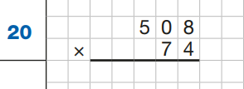










Slide 20
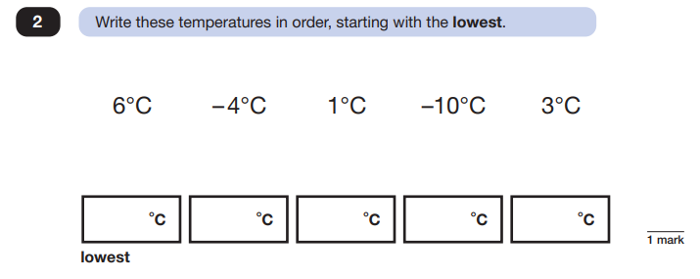
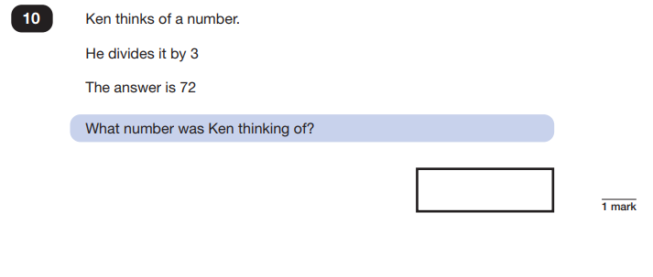
Papers 2and 3 reasoning papers 40 minutes each Total of 35 marks for each

Slide 21
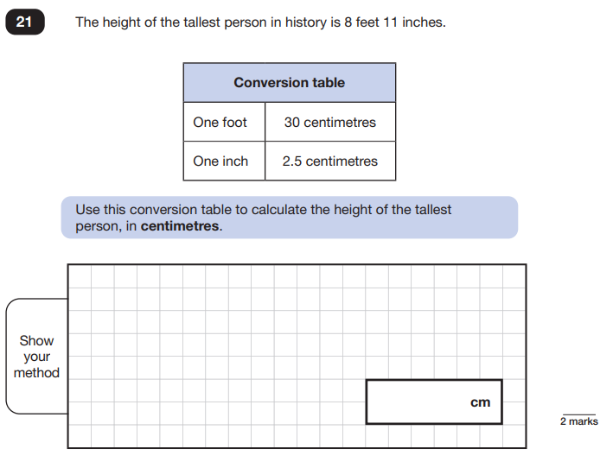

Slide 22
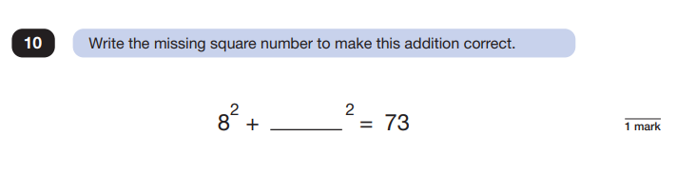
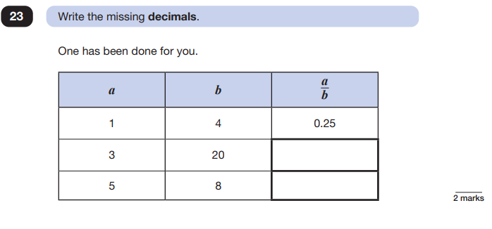

Slide 23
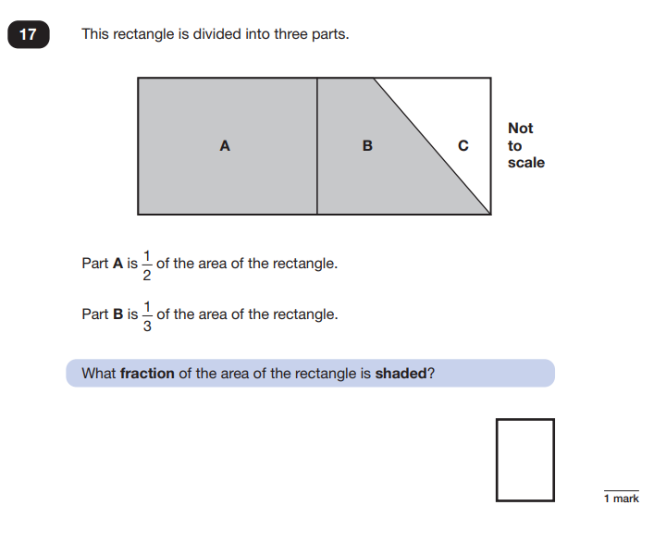

Slide 24
Maths test results Arithmetic paper is out of 40 marks, each of the reasoning papers are out of 35 marks, giving a total of 110 marks. Results from all 3 papers are added together to give an overall test score, this is then translated to a standardised score. A standardised score of 100-109 is classed as age related expectation. 110 and above is at greater depth/ higher standard. For the 2025 paper you needed to score at least 58 marks to score age related expectation. 95 marks would have been greater depth/ higher standard.
Notes:
SM

Slide 25
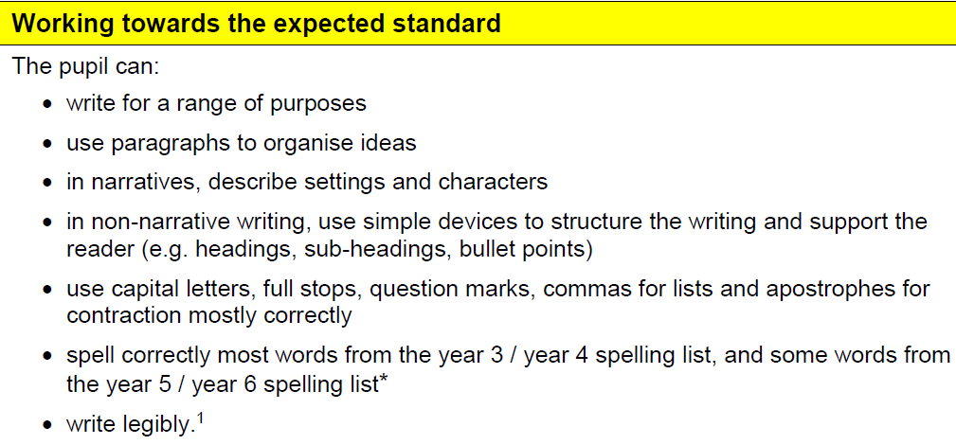
Writing will be teacher assessed as working towards the expected standard, working at the expected standard or working at greater depth. Clear criteria to show evidence for.
Notes:
AM

Slide 26
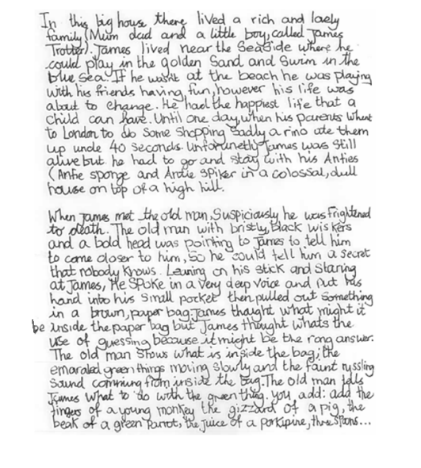
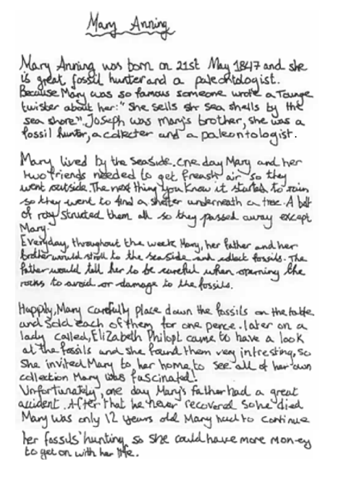
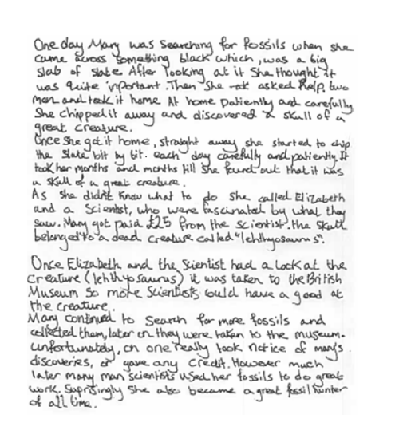

Slide 27
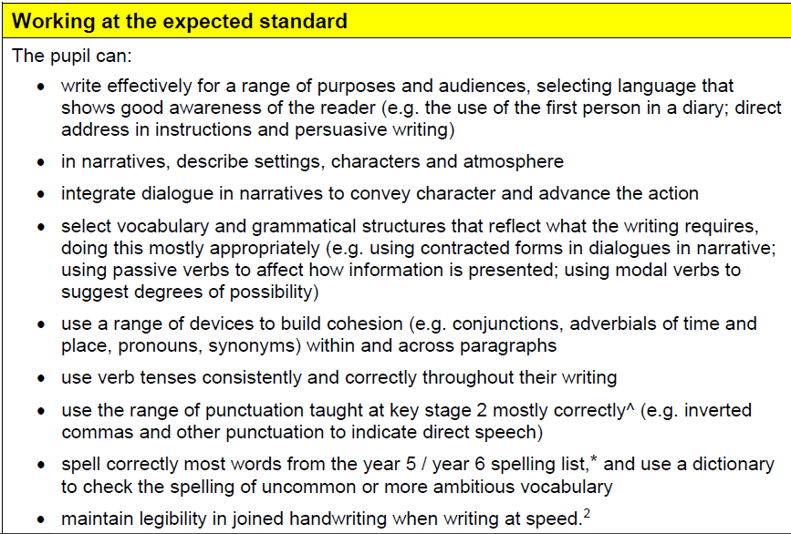

Slide 28
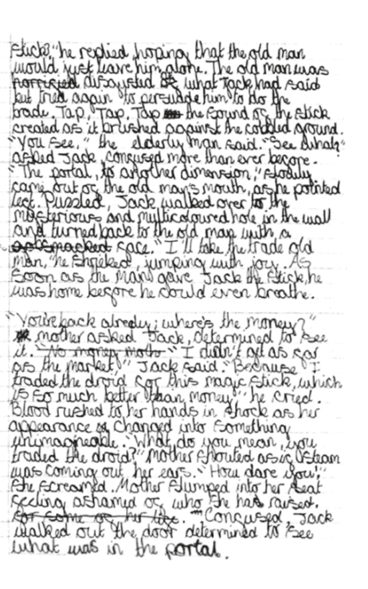
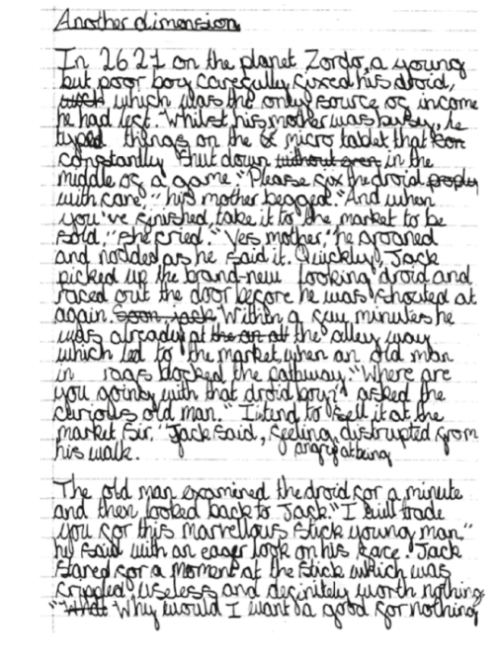
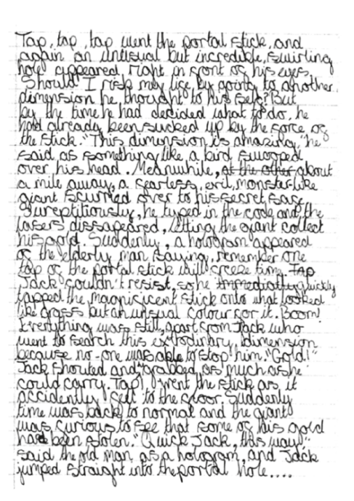
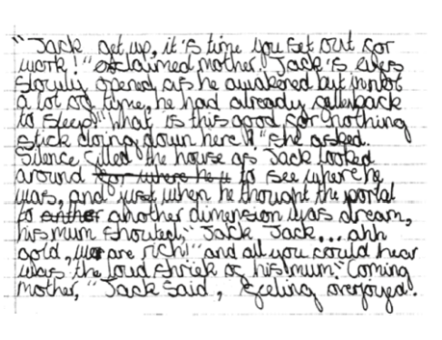

Slide 29
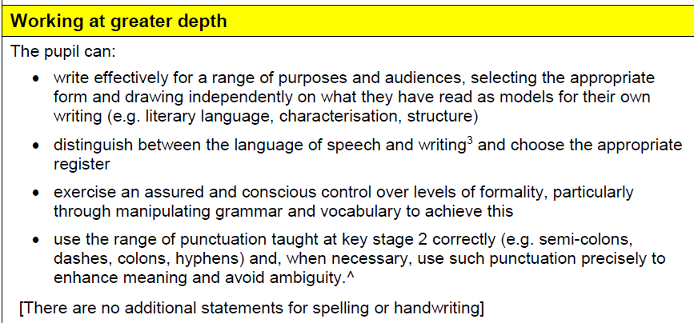

Slide 30
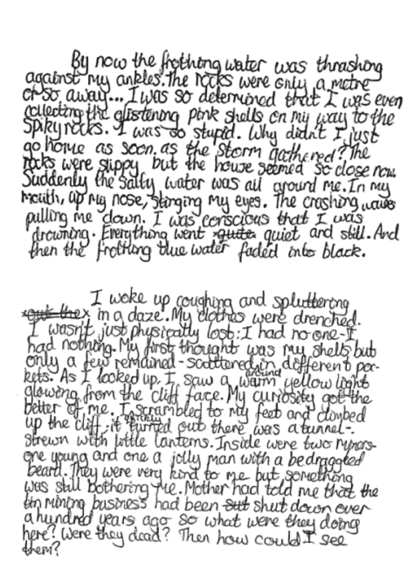
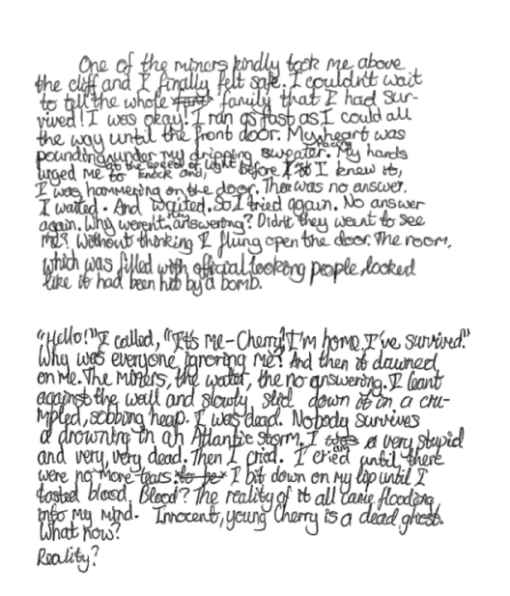


Slide 31
So what can we all do to help our year 6 be ready for the tests and for secondary school?
In school we already providing additional support and boosters to the children to help consolidate their learning from year 6 and previous years and to help prepare them for what to expect in the tests.
We have purchased CGP books and revision guides to use with all of year 6.
At home there are also many ways that you can support your child:
Continue to read with your child and ask questions about the characters, setting, plot and subject matter. This will further support their fluency and comprehension skills. Get them to read aloud regularly to help develop fluency and speed.
Practise weekly spellings and spellings from the year 5 and 6 list which they have in their homework diaries.
Discuss the meanings of words as part of general conversations.
Notes:
NW

Slide 32
Practise times tables. Speed and accuracy of table recall is key to all areas of maths so any quick-fire practice will help to build your child’s confidence as a mathematician.
Solve real life maths problems - Maths is everywhere and children really benefit from experiencing and practising maths in real-life and daily contexts. This could be calculating travel time, weighing ingredients, adding up bills, calculating the time until bed or their next tv show or even just counting.
Please ensure homework is completed each week and let us know of any concerns.
Together we can really ensure that all of the children are ready for the tests which will mean they are in an excellent position to cope with secondary school.

Slide 33
Revision guides are available to purchase from the school office. Helpful websites- Mathsbot Times Tables Rockstars Gary Hall SATs organiser Reading Plus Mathletics Spellzone Spellingframe Support that will be on school website- Year six revision for maths and grammar terminology can be found in- Curriculum- Year 6 -SATs information Along with sample papers. Information pack for you to take home with timetable, guidance on the tests and example questions from previous tests.

